Slide 1
CS 2200
LAB 2

Slide 2
Announcements
Office hours started last week, check Canvas homepage for schedule
Office hours changes will be announced on Ed
Homework 2 will be released after lab and is due Jan 31st @ 6:15 PM
Project 1 has been released (get started early!) and is due Feb 9th @ 11:59 PM

Slide 3
Brief Overview:
Padding Review, Assembly, Calling Convention, Docker Installation, CircuitSim Tips

Slide 4
Padding in C cont.
struct B {
short s; // 2 bytes
int i; // 4 bytes
short s2; // 2 bytes
};
struct C {
int i; // 4 bytes
short s; // 2 bytes
short s2; // 2 bytes
};
Let’s revisit struct B
What goes where?
What did you get from your calculation?
 | +0 | +1 | +2 | +3 | +4 | +5 | +6 | +7 | +8 | +9 | +10 | +11
0x00
0x0c
B
C

Slide 5
Padding in C cont.
struct B {
short s; // 2 bytes
int i; // 4 bytes
short s2; // 2 bytes
};
struct C {
int i; // 4 bytes
short s; // 2 bytes
short s2; // 2 bytes
};
What did we get?
Padding!
 | +0 | +1 | +2 | +3 | +4 | +5 | +6 | +7 | +8 | +9 | +10 | +11
0x00 | s0 | s1 |  |  | i0 | i1 | i2 | i3 | s0 | s1
0x0c
B
C
Struct B takes up 12 bytes of space
Memory addresses 0x02, 0x03, 0x0a, 0x0b are used as padding

Slide 6
Padding in C cont.
struct B {
short s; // 2 bytes
int i; // 4 bytes
short s2; // 2 bytes
};
struct C {
int i; // 4 bytes
short s; // 2 bytes
short s2; // 2 bytes
};
Now let’s do struct C
Has the same members as B, just arranged differently
Padding!
 | +0 | +1 | +2 | +3 | +4 | +5 | +6 | +7 | +8 | +9 | +10 | +11
0x00 | s0 | s1 |  |  | i0 | i1 | i2 | i3 | s0 | s1
0x0c
B
C
Struct B takes up 12 bytes of space
Memory addresses 0x02, 0x03, 0x0a, 0x0b are used as padding

Slide 7
Padding in C cont.
struct B {
short s; // 2 bytes
int i; // 4 bytes
short s2; // 2 bytes
};
struct C {
int i; // 4 bytes
short s; // 2 bytes
short s2; // 2 bytes
};
What did we get for struct C?
 | +0 | +1 | +2 | +3 | +4 | +5 | +6 | +7 | +8 | +9 | +10 | +11
0x00 | s0 | s1 |  |  | i0 | i1 | i2 | i3 | s0 | s1
0x0c | i0 | i1 | i2 | i3 | s0 | s1 | s0 | s1
B
C
Struct B takes up 12 bytes of space in mem
Struct C takes up 8 bytes of space in mem

Slide 8
Padding in C cont.
struct B {
short s; // 2 bytes
int i; // 4 bytes
short s2; // 2 bytes
};
struct C {
int i; // 4 bytes
short s; // 2 bytes
short s2; // 2 bytes
};
Rule of thumb: Arranging struct members in decreasing order of size will minimize padding!
Will allow more efficient use of memory space while retaining memory access efficiency
 | +0 | +1 | +2 | +3 | +4 | +5 | +6 | +7 | +8 | +9 | +10 | +11
0x00 | s0 | s1 |  |  | i0 | i1 | i2 | i3 | s0 | s1
0x0c | i0 | i1 | i2 | i3 | s0 | s1 | s0 | s1
B
C
Struct B takes up 12 bytes of space in mem
Struct C takes up 8 bytes of space in mem

Slide 9
Assembly Exercises

Slide 10
Problem 1
Write a program that adds the values in $s0 and $s1 together and doubles it, storing the output into $v0.

Slide 11
Problem 1
Write a program that adds the values in $s0 and $s1 together and doubles it, storing the output into $v0.
Pseudo-code Implementation
v0 = s0 + s1
v0 = v0 * 2 = v0 + v0

Slide 12
Problem 1
Write a program that adds the values in $s0 and $s1 together and doubles it, storing the output into $v0.
Pseudo-code Implementation
v0 = s0 + s1
v0 = v0 * 2 = v0 + v0
Assembly Code
add $v0, $s0, $s1
add $v0, $v0, $v0

Slide 13
Problem 2
Write a program that subtracts index 3 and 4 of an array pointed to by $sp, and store the result into $v0.

Slide 14
Problem 2
Write a program that subtracts index 3 and 4 of an array pointed to by $sp, and store the result into $v0.
Pseudo-code Implementation
v0 = $sp[3] - $sp[4]

Slide 15
Problem 2
Write a program that subtracts index 3 and 4 of an array pointed to by $sp, and store the result into $v0.
Pseudo-code Implementation
t0 = mem[$sp + 3]
t1 = mem[$sp + 4]
v0 = t0 - t1

Slide 16
Problem 2
Write a program that subtracts index 3 and 4 of an array pointed to by $sp, and store the result into $v0.
Pseudo-code Implementation
t0 = mem[$sp + 3]
t1 = mem[$sp + 4]
v0 = t0 - t1
Assembly Code
lw $t0, 3($sp)
lw $t1, 4($sp)
nand $t2, $t1, $t1
addi $t2, $t2, 1
add $v0, $t0, $t2

Slide 17
Problem 3
Write a program that repeatedly subtracts 5 from $s0, a number of times equal to the value in $s1, and then store the value in the memory address that $sp points to.

Slide 18
Problem 3
Write a program that repeatedly subtracts 5 from $s0, a number of times equal to the value in $s1, and then store the value in the memory address that $sp points to.
Pseudo-code Implementation
for 0..$s1
$s0 = $s0 - 5
end
mem[$sp] = $s0

Slide 19
Problem 3
Write a program that repeatedly subtracts 5 from $s0, a number of times equal to the value in $s1, and then store the value in the memory address that $sp points to.
Pseudo-code Implementation
while $s1 != 0
$s0 = $s0 - 5
$s1 = $s1 - 1
endwhile
mem[$sp] = $s0

Slide 20
Problem 3
Write a program that repeatedly subtracts 5 from $s0, a number of times equal to the value in $s1, and then store the value in the memory address that $sp points to.
Assembly Code
while: beq $s1, $zero, end
addi $s0, $s0, -5
addi $s1, $s1, -1
beq $zero, $zero, while
end: sw $s0, 0($sp)
halt
Pseudo-code Implementation
while $s1 != 0
$s0 = $s0 - 5
$s1 = $s1 - 1
endwhile
mem[$sp] = $s0

Slide 21
Functions

Slide 22
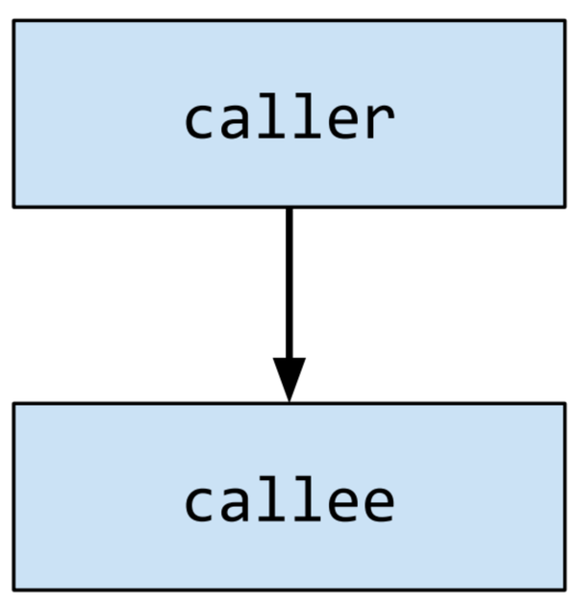
Caller: The function that calls another function.
Callee: The function that is called by the caller.

Slide 23
Saving State
Processor state needs to be maintained between multiple function calls.
We do not want the registers that the caller is using in its function to be changed by the callee, yet the callee still needs to have registers to execute with.
The solution is to save the state of the registers using one of two approaches:
Shadow register files
Main memory stack

Slide 24
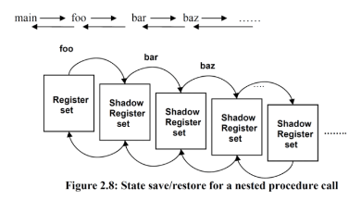
Saving State: Shadow Registers
Have multiple sets of registers.
When a function is called, switch registers sets.
Pros: Very fast!
Memory accesses to registers are much faster, so copy data over is much faster.
Cons: Poor scalability
Consider a recursive function, how many shadow rf’s will we need? A lot

Slide 25
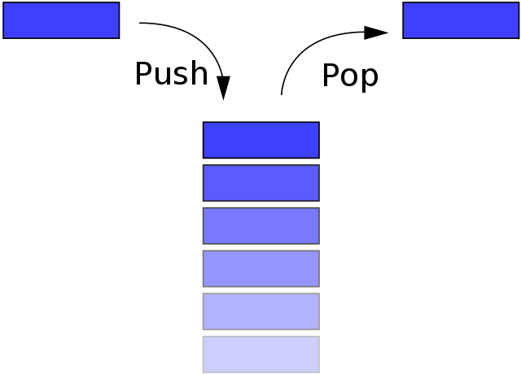
Saving State: The Stack
Store processor state information in main memory, using a stack.
Create a “calling convention” to ensure appropriate saving/restoring of information.
Do all registers need to be saved every time we call a function?
Keep track of the top of the stack with a stack pointer, storing it in $sp for LC-2200.

Slide 26
Activation Record
Local Variables
Saved S registers
Previous Frame Pointer
Previous Return Address
Saved T registers
The part of the stack relevant to the executing procedure.
Registers, data, etc. important to its functionality
Many activation records can be on the stack (think multiple function calls), but only one is considered “active” at a time.
Activation Record
Activation Record
Activation Record
Activation Record
Activation Record

Slide 27
Frame Pointer
Problem: As we push/pop items from the stack, the position of the stack pointer changes.
Would require careful monitoring by the callee to manage offsets.
Solution: Store a frame pointer in $fp, set to the bottom of the current activation record.
“Anchors” the current frame so that we always know where it starts.

Slide 28
Calling Convention

Slide 29
Register Name | Use | Callee Save?
$zero | Always zero | n/a
$at | Target Address | n/a
$v0 | Return Value | no
$a0..a2 | Argument | no
$t0..t2 | Temporary Registers | no
$s0..s2 | Saved Registers | yes
$k0 | Interrupt Return Address | n/a
$sp | Stack Pointer | no
$fp | Frame Pointer | yes
$ra | Return Address | no

Slide 30
Calling Convention
A standardized method for functions to be implemented and called by the machine.
Specifies the method that a compiler sets up to access a subroutine.
Important, since if we have programs that are compiled using different compilers, they must still be able to interface accordingly.
Specify how arguments are passed to a function, how return values are passed back out of a function and how the function is called.
“How C functions are converted into Assembly”

Slide 31
LC 2200 Calling Convention
Things we have to decide when writing a calling convention :
Parameter passing
First three arguments passed through registers ($a0-$a2), rest through the stack.
Transfer Control to Callee
jalr $ra, $at - Saves return address to $ra (caller PC+1) and jumps to address in $at (target address register).
Local variables
Allocated onto the stack, determined by calling convention.
Return values
First value stored on register $v0, others stored on stack if needed.
Transfer control back to Caller
jalr $zero, $ra - jumps to address in $ra and stores return address in $zero - to be ignored; this is essentially an unconditional jump.

Slide 32
Stack
Step 1:
Caller saves any of the registers t0-t2 on the stack (if it needs the values in them upon return)
Saved t Registers
Stack Pointer
Notes:
Which are optional and which are not

Slide 33
Stack
Step 2:
Caller places the function parameters in registers a0-a2. If there are additional parameters, the caller puts them on the stack.
Additional parameters (from function call)
Saved t Registers
Stack Pointer

Slide 34
Stack
Step 3:
Caller allocates space for any additional return values on the stack. This is only done if the return value cannot fit in v0.
Additional return values
Additional parameters (from function call)
Saved t Registers
Stack Pointer

Slide 35
Stack
Step 4:
Caller saves previous return address stored in register ra onto the stack.
Previous return address (from $ra)
Additional return values
Additional parameters (from function call)
Saved t Registers
Stack Pointer

Slide 36
Stack
Step 5:
Caller executes JALR $at, $ra. This has no effect on the stack.
Previous return address (from $ra)
Additional return values
Additional parameters (from function call)
Saved t Registers
Stack Pointer

Slide 37
Stack
Step 6:
Callee saves the previous frame pointer on stack. Then it copies the current value of the stack pointer ($sp) into the frame pointer ($fp).
Previous Frame Pointer
Previous return address (from $ra)
Additional return values
Additional parameters (from function call)
Saved t Registers
Stack Pointer
Frame Pointer

Slide 38
Stack
Step 7:
Callee saves any of the s0-s2 registers it plans to overwrite onto the stack. For simplicity, we can say that it always saves s0-s2 onto the stack.
Saved s0-s2 Registers
Previous Frame Pointer
Previous return address (from $ra)
Additional return values
Additional parameters (from function call)
Saved t0-t2 Registers
Stack Pointer
Frame Pointer

Slide 39
Stack
Step 8:
Callee allocates space on the stack for any local variables. This is the reason the frame pointer is important.
At this point, Callee does all its stuff, and stores the return values as necessary.
Stack Pointer
Allocate space for Local Variables
Saved s0-s2 Registers
Previous Frame Pointer
Previous return address (from $ra)
Additional return values
Additional parameters (from function call)
Saved t0-t2 Registers
Frame Pointer

Slide 40
Stack
Step 9:
Prior to return, Callee restores the s0-s2 registers with the values on the stack.
Saved s0-s2 Registers
Previous Frame Pointer
Previous return address (from $ra)
Additional return values
Additional parameters (from function call)
Saved t0-t2 Registers
Stack Pointer
To s registers
Frame Pointer

Slide 41
Stack
Step 10:
Prior to return, Callee restores the old frame pointer from the stack.
Previous Frame Pointer
Previous return address (from $ra)
Additional return values
Additional parameters (from function call)
Saved t0-t2 Registers
Stack Pointer
To Frame Pointer

Slide 42
Stack
Step 11:
Callee executes jump to return address: JALR $ra, $zero. No change to the stack.
Previous return address (from $ra)
Additional return values
Additional parameters (from function call)
Saved t0-t2 Registers
Stack Pointer

Slide 43
Stack
Step 12:
Upon return, Caller restores the previous return address to ra.
Previous return address (from $ra)
Additional return values
Additional parameters (from function call)
Saved t0-t2 Registers
Stack Pointer
To ra

Slide 44
Stack
Step 13:
Upon return, Caller stores the additional values as desired.
Additional return values
Additional parameters (from function call)
Saved t0-t2 Registers
Stack Pointer
As desired

Slide 45
Stack
Step 14:
Upon return, Caller moves stack pointer to discard additional parameters.
Saved t0-t2 Registers
Stack Pointer

Slide 46
Stack
Step 15:
Upon return, Caller restores any saved t0-t2 registers from the stack.
Saved t0-t2 Registers
Stack Pointer
To t Registers

Slide 47
Stack
Done!

Slide 48
LC-2200 Calling Convention Examples

Slide 49

Let’s become a compiler!

Slide 50
C Function
this we need to do:
initialize the stack
initialize the parameters
call into foo
store $fp onto the stack
carry out the calculation
restore values from the stack
teardown the stack
return
halt
int foo(int a, int b, int c, int d)
{
int x = c + d;
int y = a + b*2
return x + y;
}
void main(int a, int b, int c, int d)
{
foo(a, b, c, d);
}
Notes:
Something yo ucan go over when you’re doing your homework. Great resource when you’re doing your homework. Compare to diagram

Slide 51
main: ! main(int a, int b, int c, int d)
! initialize the stack pointer
lea $sp, STACK
lw $sp, 0($sp)
STACK: .fill 0xFFFF
A: .fill 0x0008
B: .fill 0x0005
C: .fill 0x000A
D: .fill 0x000D

Slide 52
main: ! main(int a, int b, int c, int d)
! initialize the stack pointer
lea $sp, STACK
lw $sp, 0($sp)
! initialize the parameters
lea $a0, A
lw $a0, 0($a0)
lea $a1, B
lw $a1, 0($a1)
lea $a2, C
lw $a2, 0($a2)
! store $t0 register
!(we’re assuming main needs $t0 later)
addi $sp, $sp, -1
sw $t0, 0($sp)
! the fourth parameter must be
! pushed onto the stack
lea $t1, D
lw $t1, 0($t1)
addi $sp, $sp, -1
sw $t1, 0($sp)
! save the prev return address
addi $sp, $sp, -1
sw $ra, 0($sp)
! call into foo
lea $t0, foo
jalr $ra, $t0
!restore $t0
lw $t0,0($sp)
addi $sp,$sp,1
halt
STACK: .fill 0xFFFF
A: .fill 0x0008
B: .fill 0x0005
C: .fill 0x000A
D: .fill 0x000D

Slide 53
foo: ! foo(int a, int b)
! store $fp onto the stack
addi $sp, $sp, -1
sw $fp, 0($sp)
add $fp, $sp, $zero
! load d from the stack
lw $t0, 2($fp)
! x = c + d
add $t0, $a2, $t0
! y = a + 2*b
add $t1, $a0, $a1
add $t1, $t1, $a1
add $v0, $t0, $t1
! restore values from the stack
add $sp, $fp, $zero
lw $fp, 0($sp)
! teardown the stack
addi $sp, $sp, 1
jalr $zero, $ra
Allocate space for Local Variables
Saved s0-s2 Registers
Previous Frame Pointer
Previous return address (from $ra)
Additional return values
Additional parameters (from function call)
Saved t0-t2 Registers

Slide 54
Datapath Design

Slide 55
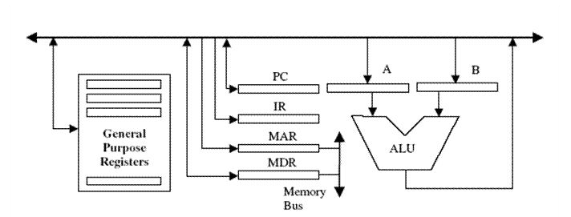
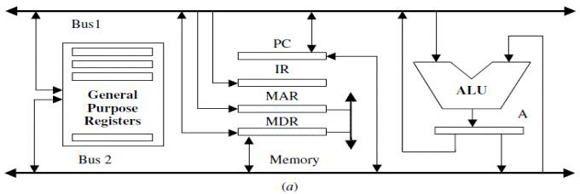
Single vs. Double Bus Design
Single Bus Design
One bus wraps around the entire datapath
Components take turns to orderly communicate
More clock cycles per instruction
Double Bus Design
Two sets of bus wires.
Two sets of data can communicate simultaneously.
More hardware = greater price and heat
Notes:
Go over adding two registers

Slide 56

Using the Bus
Regardless of bus design, we need the following for the datapath to work.
One component outputs data on one bus at one time. Every other component will be listening to the output on that bus.
We use tri-state buﬀers (bus drivers) to ensure that only one component is outputting to the bus at a time. The tri-state buﬀers are hooked up to the DrX control signals.
We use the register “enable” input to ensure that only devices which want to store the data do so. This is done using the LdXX control signals.

Slide 57
Docker Installation
Canvas > Files > docker.zip

Slide 58
Circuit Sim

Slide 59


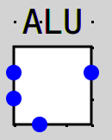
Advice for CircuitSim
Use subcircuits where necessary, they save space and abstract away logic. Please do not use subcircuits for single registers!
Tunnels are an excellent way to clean up your circuit, and make it more comprehensible.
Labels all you components, makes things easy to see and understand when wiring.
Place probes in important areas in order to visualize the inputs into a component.
Breakpoints stops the clock when a line reaches a certain value, this may be very useful for debugging.
Write your own diagnostic tests in asm to validate the execution of part of the CPU, for example write a few lines of assembly that only test the ALU.

Slide 60
Circuit Sim Demonstration
(Tips and Tricks from the TA’s)

Slide 61
Revision Notes
Allocate space for Local Variables
Saved s0-s2 Registers
Previous Frame Pointer
Previous return address (from $ra)
Additional return values
Additional parameters (from function call)
Saved t0-t2 Registers
Local Variables
Saved S registers
Previous Frame Pointer
Previous Return Address
Saved T registers
Activation Record
Activation Record
Activation Record
Activation Record
Activation Record

Slide 62
Thanks for Attending :)

